Slide 1
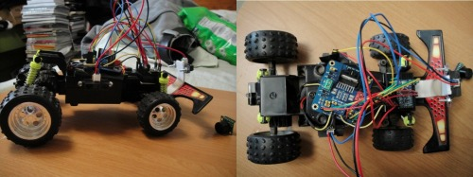
The Distance Sensing Car
-An Arduino Porject

Slide 2
About The Car
Automatic Distance Sensing Car
Automatic Start by Sound
Programmable
Driverless Car

Slide 3
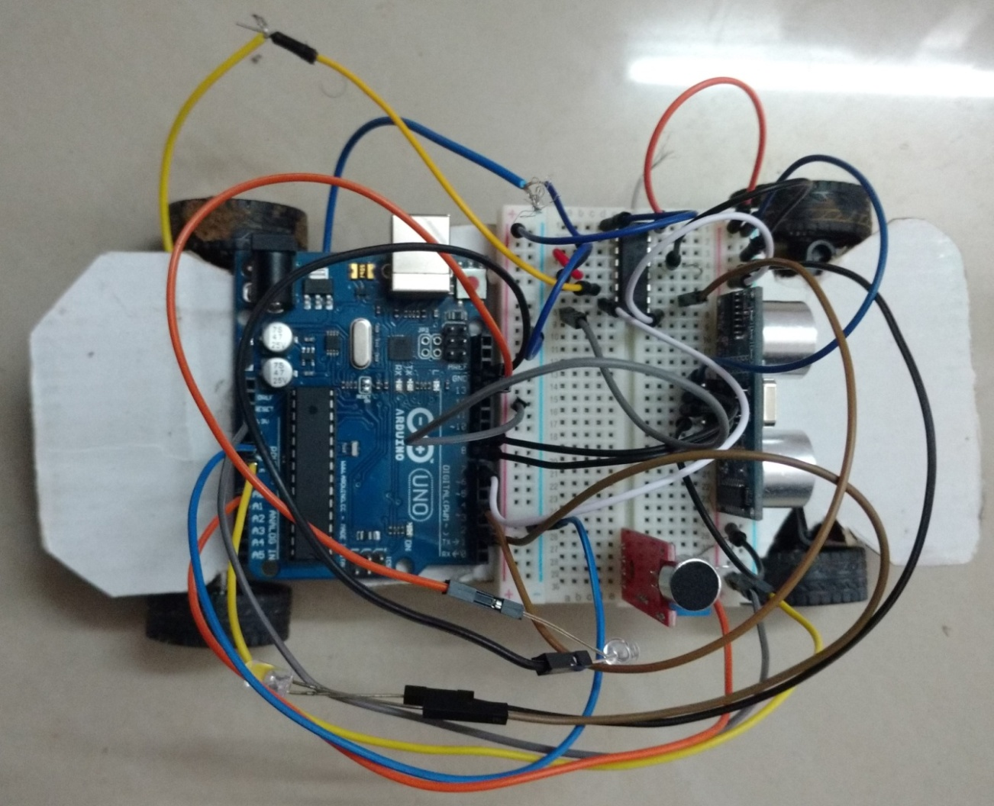
Circuit

Slide 4
Components
Distance Sensor
Sound Sensor
LEDs
RC car parts

Slide 5
Jumper wires
Bread board
Batteries
Arduino board

Slide 6
Program code
#define motor 7
#define led 12
#define trig 8
#define echo 3
#define led1 13
int flag=0;
int duration,distance;
int thresold=80;
int volume,volume1;

Slide 7
void setup() {
Serial.begin(9600); // put your setup code here, to run once:
pinMode(motor,OUTPUT);
pinMode(led,OUTPUT);
pinMode(echo,INPUT);
pinMode(trig,OUTPUT);
pinMode(led1,OUTPUT);
}

Slide 8
void loop() {
volume=analogRead(A0);
if(volume>=thresold){flag++;
while(flag!=0)
{digitalWrite(led1,LOW);
digitalWrite(trig,HIGH);
delay(100);
digitalWrite(trig,LOW);
duration=pulseIn(echo,HIGH);
distance=(duration/2)/29.1;

Slide 9
if(distance<=10)
{
digitalWrite(led,LOW);
//delay(2000);
digitalWrite(motor,HIGH);
//delay(2000);// put your main code here, to run repeatedly:
}

Slide 10
else
{
digitalWrite(led,HIGH);
digitalWrite(motor,LOW);
}
}
}
else digitalWrite(led1,HIGH);
}

Slide 11
Thank
You

